Slide 1
SALES ROLES & RESPONSIBILITIES
Dustin Troutman
09/08/2023
The content of this document is the exclusive confidential property of Creative Composites Group. Copying, disclosure to others or other use is prohibited without the express written authorization of CCG. Any third party is strictly prohibited from reading, using, disclosing, distributing or copying the content of this document and all associated detail within it. You should not rely on, or take, or fail to take any action based upon the content of this document.

Slide 2
CREATIVE COMPOSITES GROUP
A SUBSIDIARY OF HILL & SMITH PLC
Integrated Sales & Marketing at a Group Level so Customers don’t Need to Figure Out Which Manufacturing Process is Best - We do That for Them
Innovative Design and Manufacturing Expertise Creates Unique Structural Products
Provides Customer-focused Engineering that Make Customer Systems Bigger, Better and Longer Lasting
FRP Composite Materials that are Lightweight, Corrosion-Resistant and Durable
Integrating Operations for More Flexible Allocation of Resources (People & Space) to Meet Customer Schedules

Slide 3
Sales Contacts – Review Product Line Slides for More Detail
Waterfront: Corey Sechler – csechler@pultrude.com
Access Structures (E.T. Techtonics): Brandon Weyant – bweyant@pultrude.com
Bridge Decking: Gregg Blaszak – gblaszak@coastlinecomposites.com; Brandon Weyant – bweyant@pultrude.com;
Concrete Form Deck Panels; Aaron Barth – Abarth@endurocomposites.com
Mass Transit: Gregg Blaszak – gblaszak@coastlinecomposites.com; Brandon Weyant – bweyant@pultrude.com; Roy Silvas – rsilvas@endurocomposites.com
Utilities (CP & EC): Terry Shank – tshank@pultrude.com; Flavio Ortiz – fortiz@endurocomposites.com
Industrial Corrosion: Jeff Wollet – jwollet@compositeadvantage.com
Building Products (EC & CP): Aaron Barth – abarth@endurocomposites.com; Brandon Weyant – bweyant@pultrude.com
Cable Management: Dan Neal – dneal@endurocomposites.com
Standard Structural Products: (CP) Jerry Miller – jmiller@pultrude.com; Todd Kagarise tkagarise@pultrude.com Note: Reference Territory Map
OEM Products (CP): Miller – jmiller@pultrude.com; Todd Kagarise tkagarise@pultrude.com Note: Reference Territory Map
Custom Molding (CA & KW): Jeff Wollet – jwollet@compositeadvantage.com
Structural Fab Services: Greg McCoy – gmccoy@pultrude.com Note: Greg to review opportunity and send it to Todd or Jerry to manage sale. Note: include Carroll and Lynn
Industrial Field Services (KW & EC): Jeff Wollet – jwollet@compositeadvantage.com; Marilee Coleman – mcoleman@endurocomposites.com
Water & Wastewater (EC): Francisco Alvidrez – falvidrez@endurocomposites.com

Slide 4
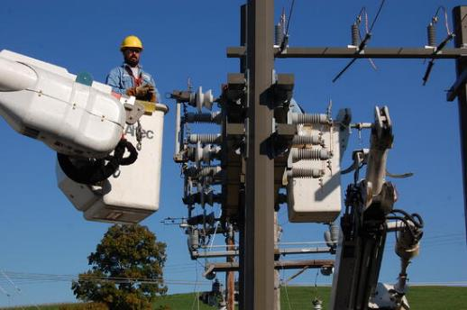
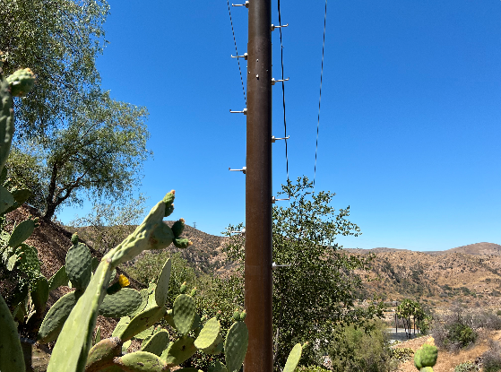
UTILITY INFRASTRUCTURE
Products: Distribution and Transmission Poles, Crossarms, X-braces, Davit Arms and Work Platforms
Brands: StormStrong®, FireStrong™, PowerTrusion
Sales Manager: Terry Shank
Product Managers: Dustin Troutman, Flavio Ortiz
Engineering Project Manager for projects primarily coming out of CP: Shane Felix
Project Manager for OEM projects primarily coming out of EC: Flavio Ortiz
Prod Dev / Sales Support: Shane Felix
Sales Rep: Terry Shank, UAI, PPR
Inside Sales Support: Conner Lazorka
Marketing: Jay Harris
Quote Review and Approval: Greg McCoy< $300K; Shane Weyant >$300K

Slide 5
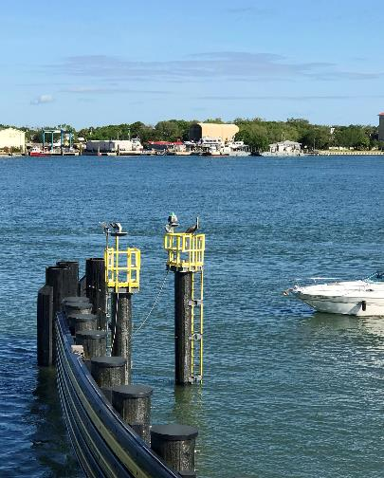
WATERFRONT INFRASTRUCTURE
Products: Pipe piles, sheet piles, wales, log, ship and sub camels, fender systems, guide walls, dolphins and specialty applications Brands: StormStrong®, SuperPile®, SuperLoc®, Harborpile, HarborCamel, FiberPile, FiberWale, FiberGuard
Sales Manager: Corey Sechler
Product Managers: Josh Driver (CA), Jordan Couture (KW), Dustin Troutman (CP)
Project Manager for projects primarily coming out of AB: Andrew Swindell
Project Manager for projects primarily coming out of Dayton: Josh Driver
Project Manager for projects primarily coming out of Augusta: Jordan Couture
Prod Dev / Sales Engineering Support: Andrew Loff, Josh Driver, Jeremy Mostoller
Sales Rep: Coastline (Steve), Schrader, Direct
Marketing: Jay Harris
Quote Review and Approval: Greg McCoy/Lynn Derouen < $300K; Shane Weyant >$300K

Slide 6
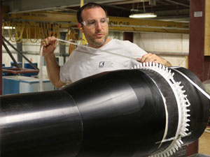
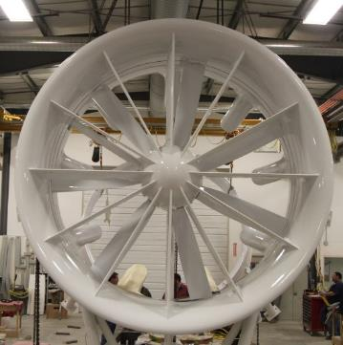
CUSTOM MOLDING (OEM INFUSED OR WOUND)
Products: Containers, Crane Pads, and Wastewater Covers…
Brands: No brand names
Sales Manager: Jeff Wollet (CA)
Product Manager: Lynn Derouen
Engineering Project Manager: Paul Dumoulin, Jordan Couture
Prod Dev / Sales Support: Adam Rose, Alex Thibodeau
Sales Rep: Jeff Wollet (CA)
Marketing: Jay Harris
Quote Review and Approval: Lynn Derouen < $300K; Shane Weyant >$300K
(Note: Intercompany Products like TT Shrouds are House Accounts)

Slide 7
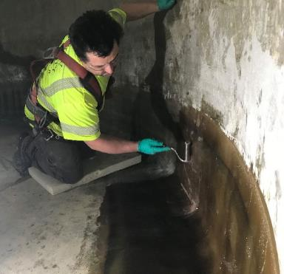
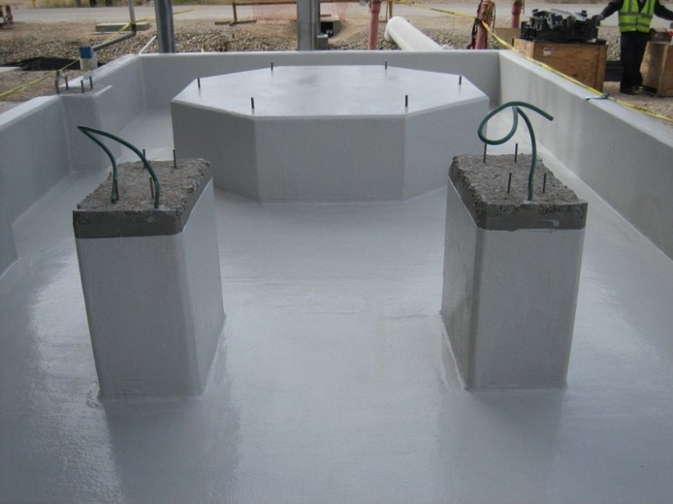
FIELD SERVICES
Services: Tank & Pipe Installation and Repair Services, Vent Stacks Services, Tank Lining Repair, Equipment Repair, Tank & Tower Installation, Water & Wastewater Treatment Products Installation, Military Equipment Repair, Infrastructure Repair, Concrete specialized coatings, Trench Covers and Relines
Brands: Kenway Field Services, Enduro Field Services
(Note: Pulp and Paper accounts stay house accounts with Kenway)
Sales Manager: Jeff Wollet (KW), Marilee Coleman (EC)
Product Manager: Alex Thibodeau
Project Manager: Paul Dumoulin, Jordan Couture, Andy Fisher (EC-Freeport), Brian Haygood (EC-W&WW)
Prod Dev / Sales Support: Alex Thibodeau
Marketing: Jay Harris
Quote Review and Approval:
Lynn Derouen < $300K; Shane Weyant >$300K

Slide 8
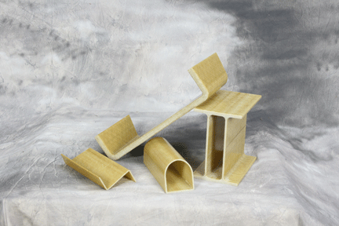
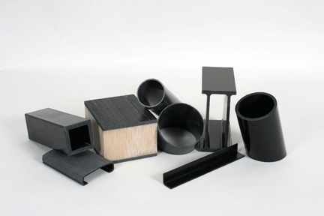
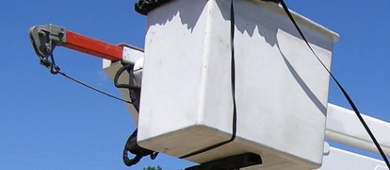
OEM & CUSTOM PULTRUDED PROFILES, FABRICATED SYSTEMS
Products: Custom profiles, polyurethane resin pultrusions, custom fabricated assemblies e.g. BAC, HWB and KOCH
Brands: Pultex®, SuperStructural, SuperGrate®, Heavy Duty Plank, SuperPlank®, FlowGrip®, SuperDeck®, SuperPanel, Ameri-Board™
Sales Manager: Jerry Miller, Todd Kagarise
Product Manager: Greg McCoy
Project Manager for projects and House Accounts: Greg McCoy
Project Manager for EC OEM and Custom Pultrusions: Flavio Ortiz
Sales Engineering Support: Jeremy Mostoller, Trent Crouse
Sales Rep: Todd Kagarise, Jerry Miller
Inside Sales Support: Trace Logue, Conner Lazorka
Marketing: Jay Harris
Quote Review and Approval: Greg McCoy < $300K; Shane Weyant >$300K

Slide 9
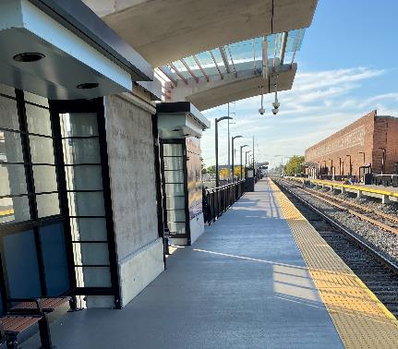
RAIL INFRASTRUCTURE (excluding third rail coverboards)
Products: Mass transit decks, Mass transit T-beams, Bridges, Access Panels, Coverboards, Cable Tray, Stepduct and Strut Framing Systems
Brands: FiberSpan™, SuperDeck® Mass Transit, Enduro
Sales Manager: Scott Reeve Transitioning to Brandon Weyant, Dan Neal (EC)
Product Manager: Scott Reeve, Greg McCoy (Pultruded MTP)
Project Manager for projects primarily coming out of CP: Jeremy Mostoller
Project Manager for projects primarily coming out of CA: Josh Driver
Project Manager for projects primarily coming out of KW: Paul Dumoulin
Prod Dev / Sales Support: Adam Rose, Jeremy Mostoller, Tom Vaughan (EC)
Sales Rep: Coastline (Gregg Blaszak)
Marketing: Jay Harris
Quote Review and Approval: Greg McCoy/Lynn Derouen < $300K; Shane Weyant >$300K

Slide 10
ACCESS STRUCTURES PEDESTRIAN BRIDGES, BOARDWALKS
Pedestrian Bridges, Boardwalks and Walkways and Molded Pedestrian T-Beam Bridges and Decks
Products: pedestrian bridges, boardwalks, walkways, planking, trusses, molded pedestrian decks
Brands: E.T. Techtonics™, Heavy Duty Plank, SuperPlank ®, FlowGrip ®, Ameri-Board™, SuperDeck® Lite Projects that are brought to our attention that require a pultruded deck with pedestrian and minimal maintenance equipment loading are managed by E.T., AASHTO deck load and engineered projects go to Coastline.
Sales Manager: Brandon Weyant
Product Manager: Dustin Troutman
Project Manager for projects coming out of CP: Dan Winey
Project Manager for projects coming out of CA: Josh Driver
Prod Dev / Sales Support: Adam Rose (CA), Dan Winey (CP)
Sales Rep: Brandon Weyant, Griffin (Broker/Distributor)
Inside Sales Support: Conner Lazorka
Marketing: Jay Harris
Territory: Global
Quote Review and Approval: Greg McCoy < $300K; Shane Weyant >$300K

Slide 11
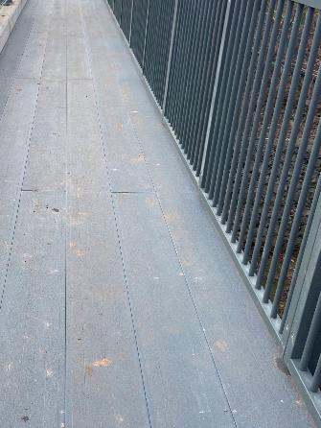
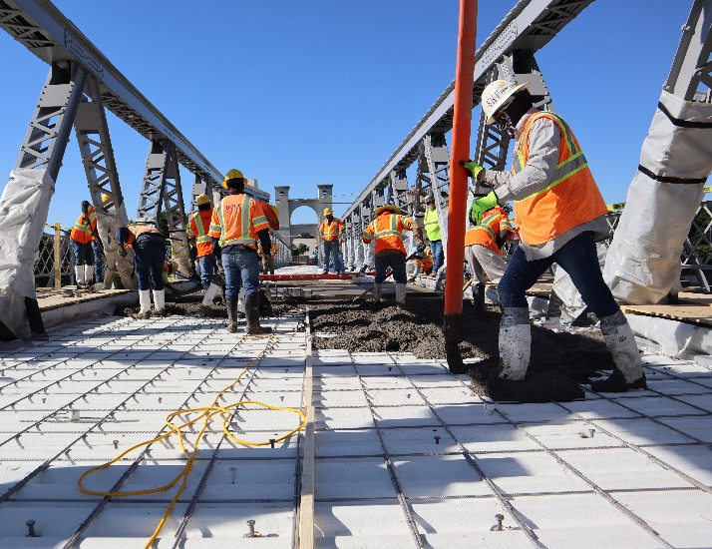
BRIDGE DECKING
Products: Rated vehicle bridge decks, cantilever sidewalks, concrete form deck panels
Brands: FiberSpan-V, FIberSpan-P, FiberSpan-C, SuperPlank, SuperDeck®, TuffSpan™
Example: Projects that are engineered by structural engineering firms and require design assistance from CCG or Enduro. Projects that start with a molded deck and transition to a pultruded deck, stay with Coastline and become a house account with Greg M. providing oversight.
Sales Manager: Scott Reeve transitioning to Brandon Weyant, Aaron Barth (EC)
Product Manager: Scott Reeve (Infused) / Dustin Troutman (Pultruded)
Project Manager for projects primarily coming out of CP: Dan Winey
Project Manager for projects primarily coming out of CA: Josh Driver
Project Manager for projects primarily coming out of KW: Paul Dumoulin
Prod Dev / Sales Support: Adam Rose, Jeremy Mostoller, Dan Winey,
Caleb Jimerson (EC)
Sales Rep: Coastline (Gregg Blaszak) for CP, KW, CA
Marketing: Jay Harris
Quote Review and Approval: Greg McCoy/Lynn Derouen < $300K;
Shane Weyant >$300K

Slide 12
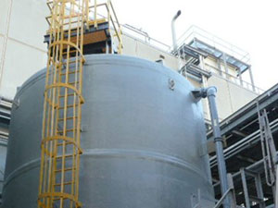
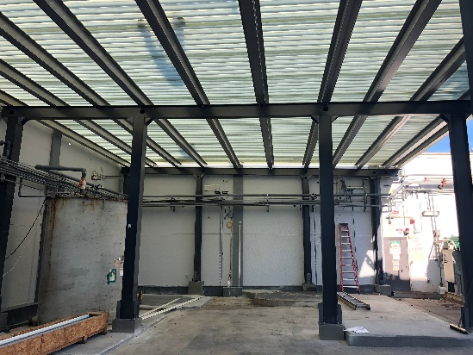
HEAVY INDUSTRIAL CORROSION
Products: Tanks, Towers and Stacks, Pipes, Scrubbers and Absorbers, Covers, Pulp Mill Equipment, Scuppers, Vessels, Custom Fabrications (e.g., Hoods), Tank Farm Canopies
Brands: Kenway, TuffSpan™
Sales Manager: Jeff Wollet
Product Manager: Alex Thibodeau
Project Manager: Paul Dumoulin, Jordan Couture
Project Manager for projects primarily coming out of EC: Kyle Johnston
Prod Dev / Sales Engineering Support: Alex Thibodeau
Sales Rep: Jeff Wollet
Marketing: Jay Harris
Quote Review and Approval: Lynn Derouen < $300K; Shane Weyant >$300K

Slide 13
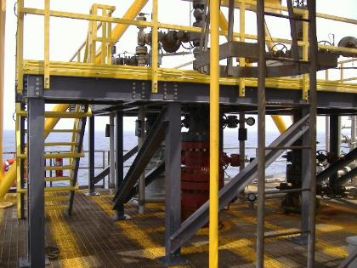
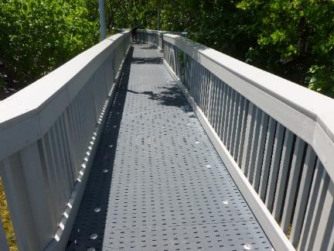
STANDARD STRUCTURAL PRODUCTS
Products: Shapes, decking, grating and ballistic panels
Brands: Pultex®, SuperStructural, SuperGrate®, Heavy Duty Plank, SuperPlank®, Flowgrip®, SuperDeck®, SuperPanel, Ameri-Board™
Sales Manager: Jerry Miller, Todd Kagarise
Product Manager: Greg McCoy
Project Manager for projects: Prod Dev / Sales Support: Trent Crouse
Sales Rep: Todd Kagarise, Jerry Miller
Inside Sales Support: Trace Logue, Conner Lazorka
Marketing: Jay Harris
Quote Review and Approval: Greg McCoy< $300K; Shane Weyant >$300K

Slide 14
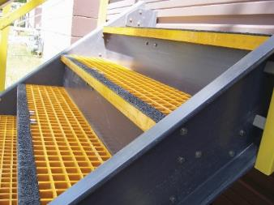
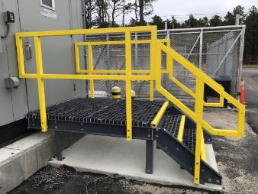
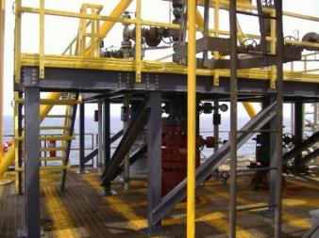
STRUCTURAL FABRICATION SERVICES
Products: Industrial and commercial access structures, structural profiles, grating, decking, handrails, safety rails, mezzanines, platforms and ladders
Brands: SupurTuf™
Sales Manager: Greg McCoy, Todd Kagarise, Jerry Miller
Product Manager: Greg McCoy
Project Manager for Projects: Carroll Armentor
Project Manager for Augusta: Jordan Couture, Paul Dumoulin
Prod Dev / Sales Support: Trent Crouse, Carroll Armentor
Inside Sales Support: Carroll Armentor
Marketing: Jay Harris
Quote Review and Approval: Lynn Derouen < $300K; Shane Weyant >$300K

Slide 15
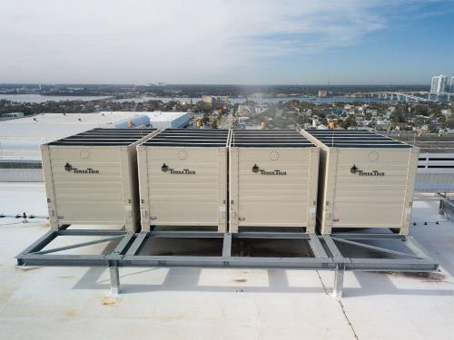
SUSTAINABLE COOLING TOWERS
Products: Open-Circuit Cooling Towers & Closed-Circuit Cooling Towers
Brands: Tower Tech®, Baby Tech™, StormStrong®
Sales Manager: Micah Curtis
Product Manager: Mathu Solo
Engineering Project Manager: John Makosky
Prod Dev / Sales Support: Mathu Solo, Micah Curtis
Sales Rep: Rob Curtis, Brian Hobbs, Kyle Amos
Inside Sales Support: Julius Thomas, James Walters
Aftermarket Parts & Customer Service: Kilder Serrano
Marketing: Jay Harris
Territory: USA, Canada, Mexico, Dominican Republic, Puerto Rico, St, Lucia, Aruba, Curacao, Brazil, Peru, Panama, Costa Rica, El Salvador, Bahrain, Qatar, Saudi Arabia, Dubai, Hong Kong, Thailand and Italy. All countries we have previously sold product to but anticipate growing to include Australia.
Quote Review and Approval: Mat Solo< $300K; Shane Weyant >$300K

Slide 16
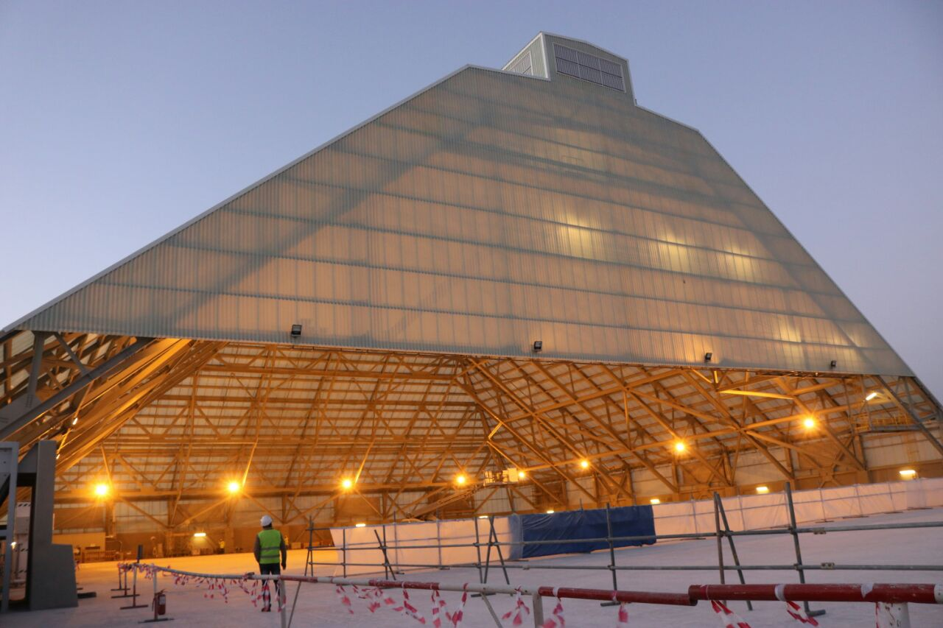
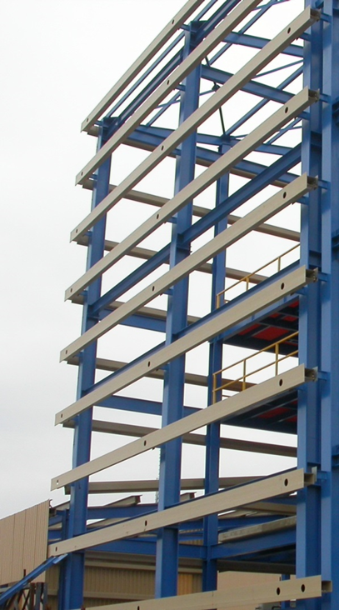
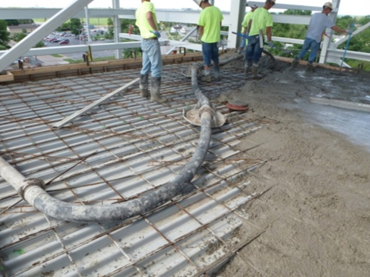
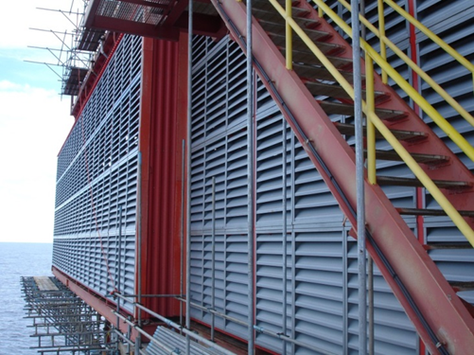
BUILDING PRODUCTS
Products: Industrial performance roof and wall panel cladding, insulated panel systems, roof deck, concrete form deck, building secondary framing (girts & purlins), primary framing, engineered FRP buildings, louvers, ridge vents, gutter, roof trusses
Brands: TuffSpan™, DuroSpan™
Channel to Market: Direct sales to owners, contractors
Sales Manager: Blake Heger, Aaron Barth
Product Manager: Blake Heger, Aaron Barth
Sales Manager Roof Trusses: Brandon Weyant (CP)
Project Manager Director: Kyle Johnston
Project Manager(s): As assigned by Kyle Johnston
Inside Sales Support: Caleb Jimerson, Joel Stelly
Marketing: Blake Heger & Jay Harris

Slide 17
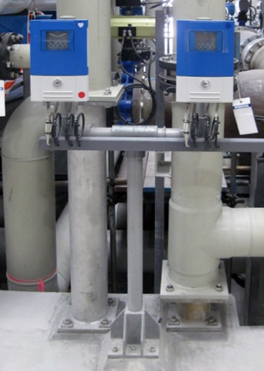
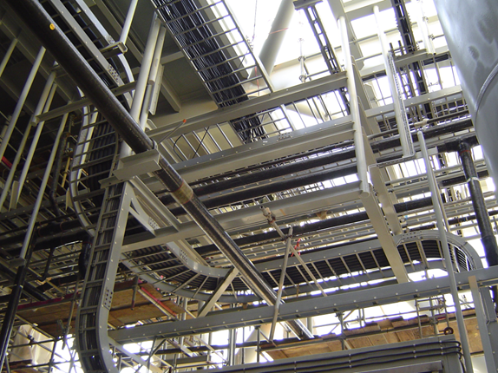
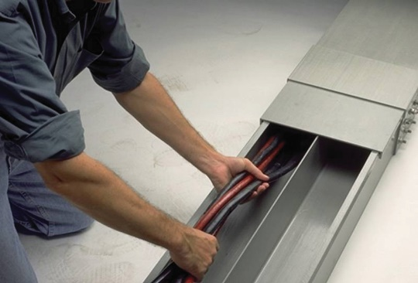
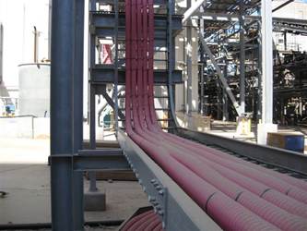
CABLE MANAGEMENT
Products: Industrial cable management product solutions include electrical and instrumentation cable ladder, cable & instrumentation tray, wireways, strut channel framing systems, instrumentation stands and switch racks
Brands: Enduro
Channel to Market: Electrical Distribution via Rep Firms
Sales Manager: Blake Heger, Dan Neal
Product Manager: Blake Heger
Inside Sales Support: Tom Vaughan
Customer Service/Project Manager: As assigned by Kyle Johnston
Marketing: Blake Heger

Slide 18
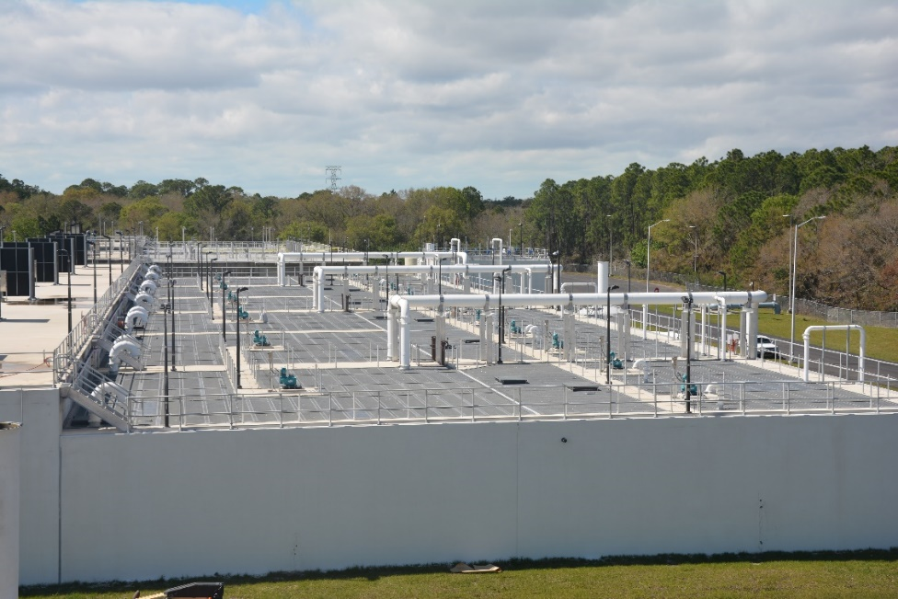
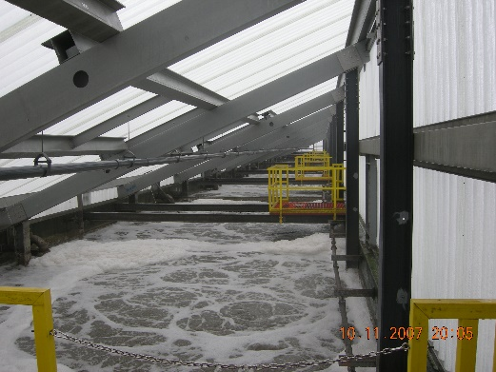
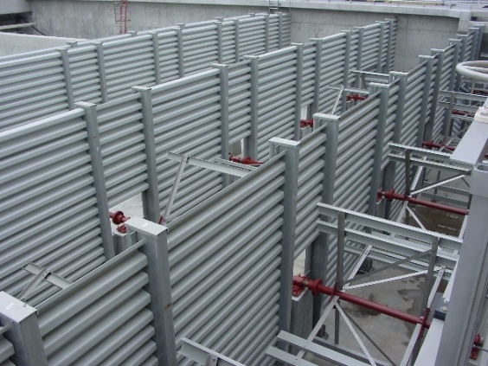
WATER & WASTEWATER STRUCTURES
Products: Includes baffle walls for improved flow control, increased contact time, mixing and separation of zones.
Brands: XL6 Tank Cover, AXS-3TM, TreadMaxTM
Channel to Market: Manufacturer Rep Firms
Sales Manager: Francisco Alvidrez
Product Manager: Francisco Alvidrez
Field Installation: Brian Haygood
Estimating: Nathan Rodriguez, Bob Strack
Project Management Director: Kyle Johnston
Project Managers: As assigned by Kyle Johnston
Marketing: Blake Heger

Slide 19
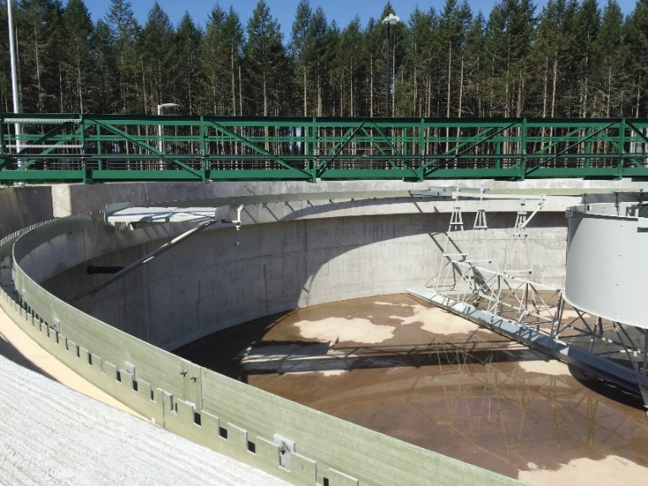
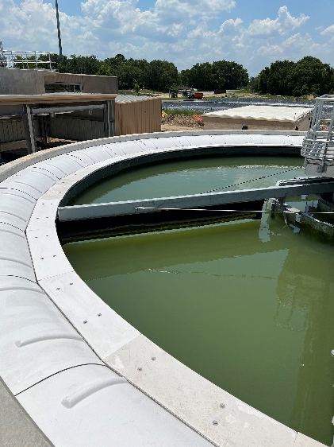
WATER & WASTEWATER - CLARIFIER PRODUCTS
Products: Clarifier components include weirs, scum baffles, density current baffles, launder troughs and launder covers.
Channel to Market: Manufacturer Rep Firms
Sales Manager: Francisco Alvidrez
Product Manager: Francisco Alvidrez
Field Installation: Brian Haygood
Estimating: Bob Strack, Nathan Rodriguez
Project Management Director: Kyle Johnston
Project Managers: As assigned by Kyle Johnston
Marketing: Blake Heger

Slide 20
APPENDIX

Slide 21
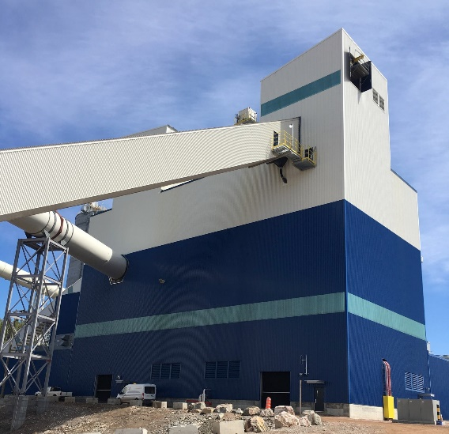
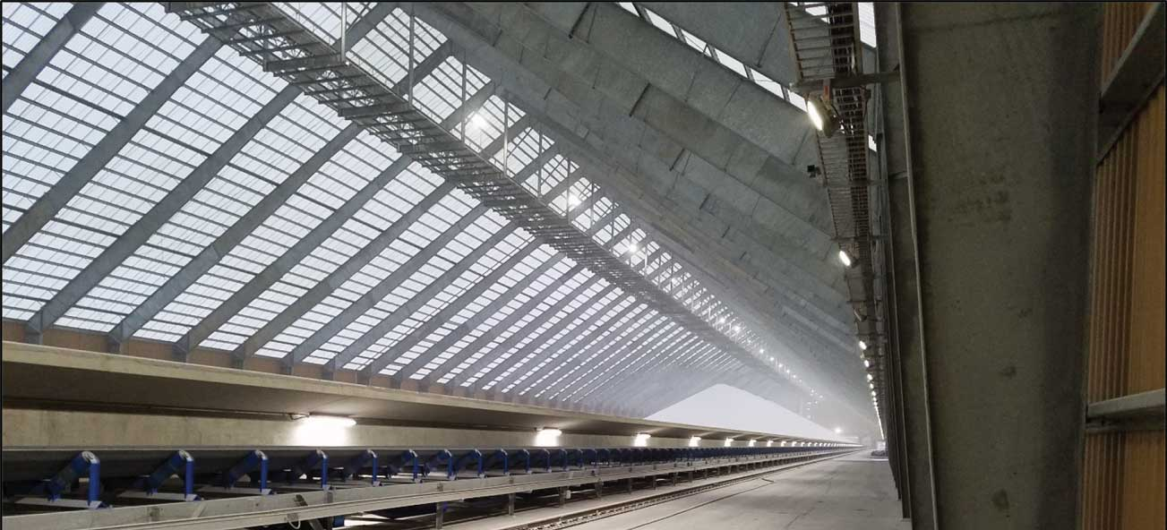
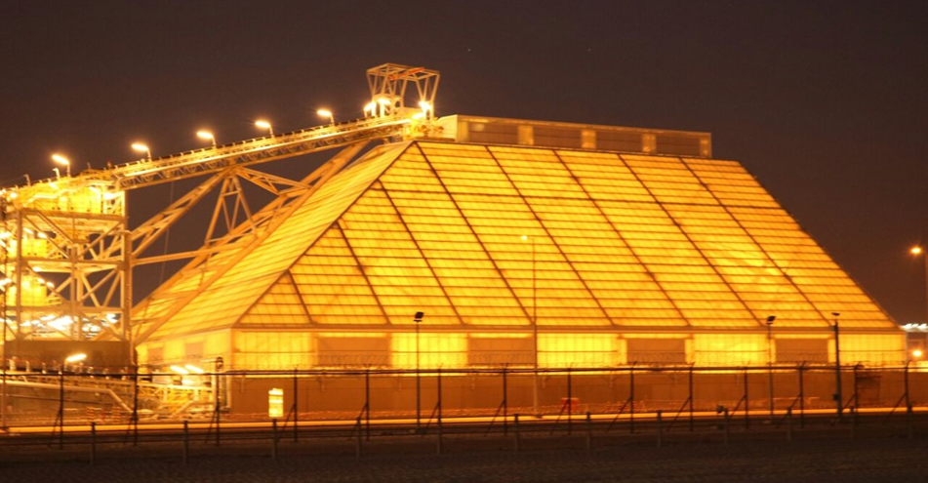
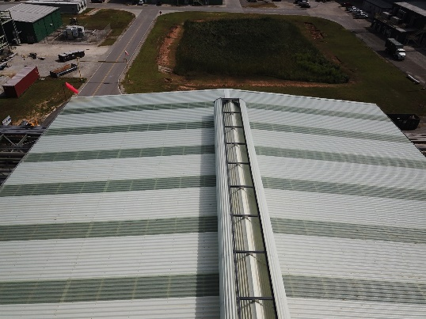
BUILDING PRODUCTS

Slide 22
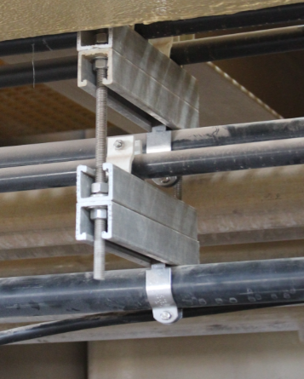
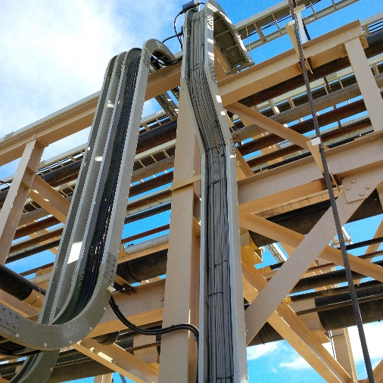
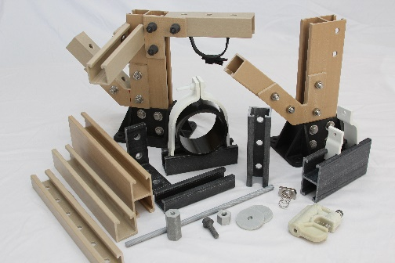
CABLE MANAGEMENT

Slide 23
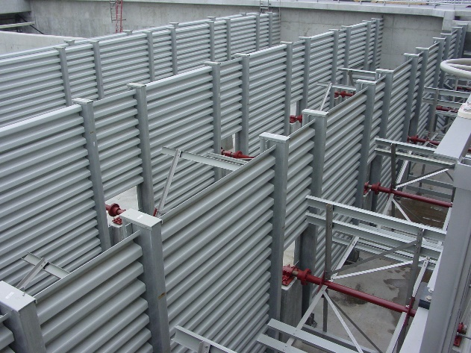
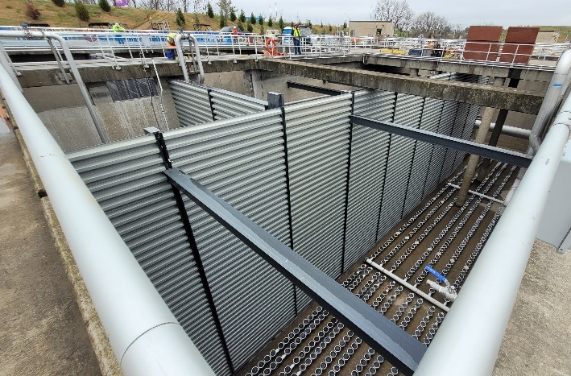
WATER & WASTEWATER STRUCTURES

Slide 24
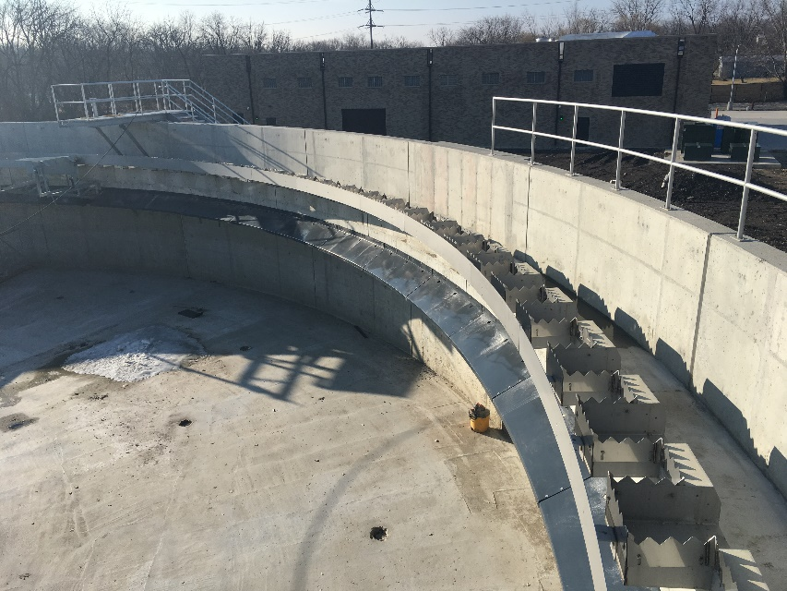
WATER & WASTEWATER - CLARIFIER PRODUCTS

Slide 25
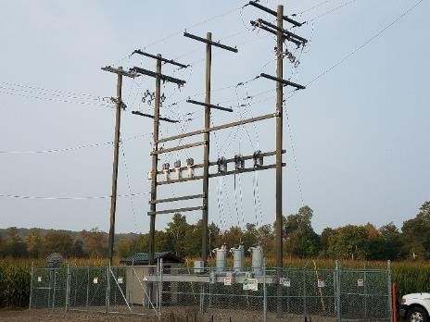
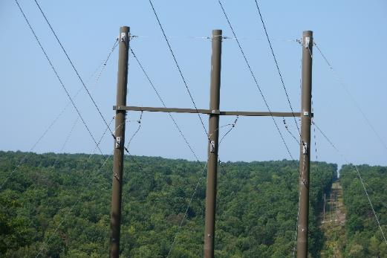
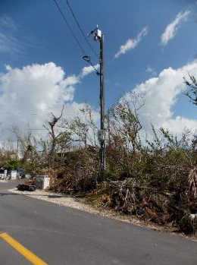
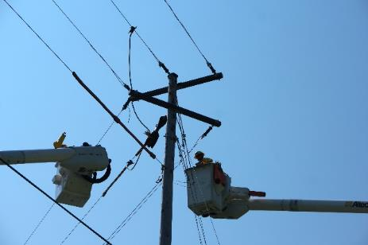
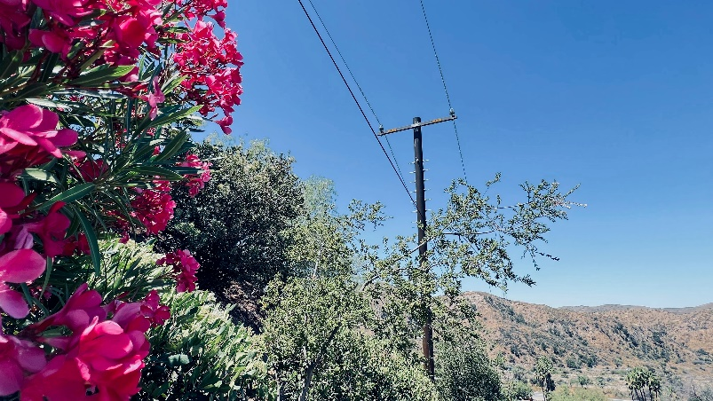
UTILITY INFRASTRUCTURE
Distribution Poles
Microcell Poles
Transmission Poles
Deadend and Tangent Crossarms
StormStrong & FireStrong Utility Poles

Slide 26
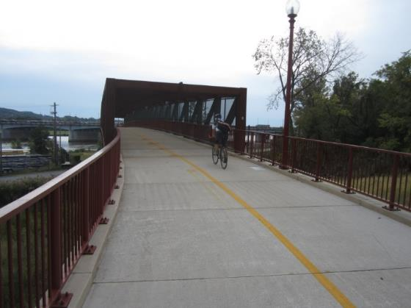
BRIDGE DECKING

Slide 27
ACCESS STRUCTURES
Bridges
Boardwalks

Slide 28
RAIL PLATFORMS AND MASS TRANSIT

Slide 29
WATERFRONT PRODUCTS
Sheet Piles
Structural Piles & Walkways
Fender Piles
Bridge Fender Systems
NAVY Camels
Camels

Slide 30
HEAVY INDUSTRIAL CORROSION
Industrial Corrosion Manufacturing
Industrial Field Service & Repair
Industrial Building Products
Municipal Wastewater & Odor Control
Structural Fabrication Services
Industrial Cable Management Products

