Slide 1

Creative Composites Group
Overview & Highlights 2023
Shane weyant
CEO

Slide 2
OUTLINE
Overview of CCG Group
  Manufacturing Divisions
  Capabilities
CCG Market Overview
  Key Industries
  FRP Benefits
CCG Industries
  Infrastructure (Waterfront / Utilities / Bridges / Water & Wastewater / Buildings / Rail)
  Pedestrian & Safety Access Structures
  OEM & Custom Manufacturing
  Cable Management
  Cooling Towers
  Industrial Corrosion & Field Services

Slide 3






CREATIVE COMPOSITES GROUP
A SUBSIDIARY OF HILL & SMITH PLC
Provides Customer-focused Engineering that Make Customer Systems Bigger, Better and Longer Lasting
FRP Composite Materials that are Lightweight, Corrosion-Resistant and Durable
Innovative Design and Manufacturing Expertise Creates Unique Structural Products
Integrated Sales & Marketing at a Group Level so Customers don’t Need to Figure Out Which Manufacturing Process is Best - We do That for Them
Integrated Pultrusion & Molding Operations for More Flexible Allocation of Resources (People & Space) to Meet Customer Schedules

Slide 4
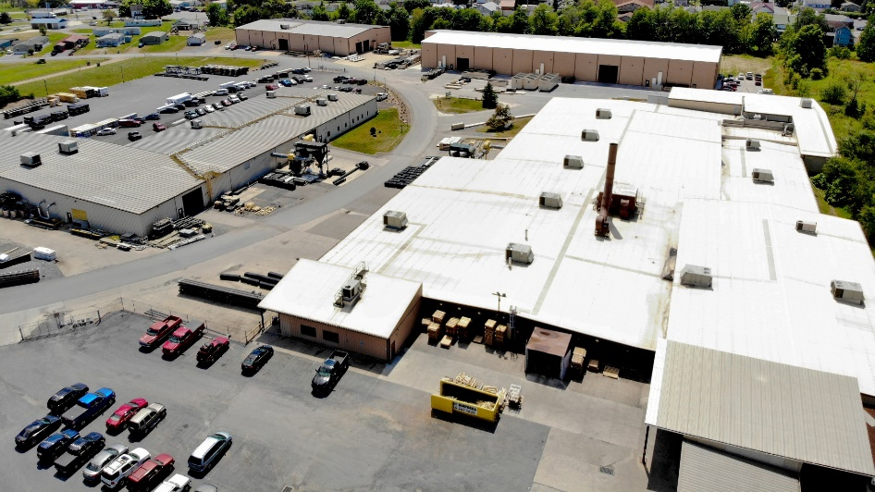
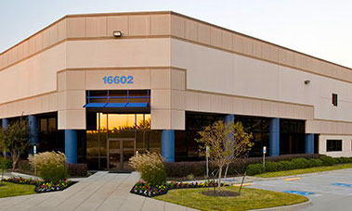
PULTRUSION DIVISION – PENSYLVANIA & TEXAS
Creative Pultrusions &
Tower Tech Manufacturing
Alum Bank, PA
  Facilities:
  164,000 sq. ft. – CP
  36,000 sq. ft. – TT
  Manufacturing
  Employees:
  210
  Manufacturing Process:
  Pultrusion
Enduro Composites
Houston, TX
Freeport, TX
Second Industrial City, Saudi Arabia
  Facilities:
  120,000 sq. ft.
  Houston Employees: 116
  Freeport Employees: 25
  Manufacturing Processes:
  Pultrusion, Molding & Continuous Lamination

Slide 5
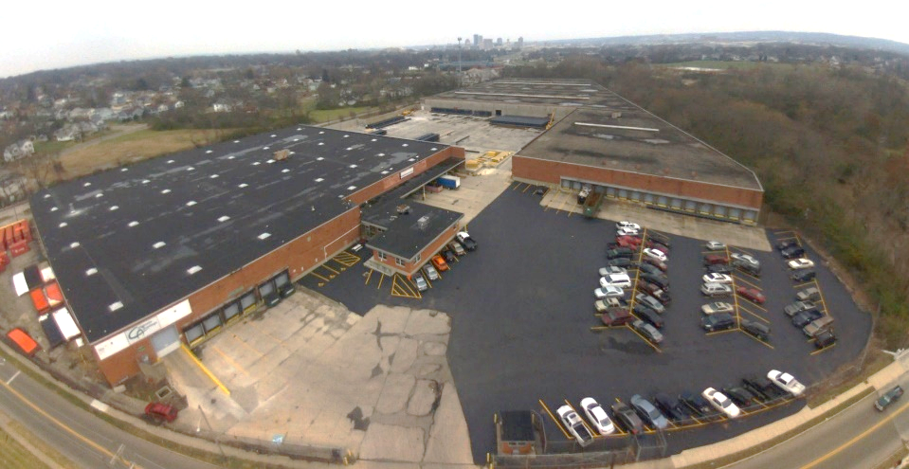
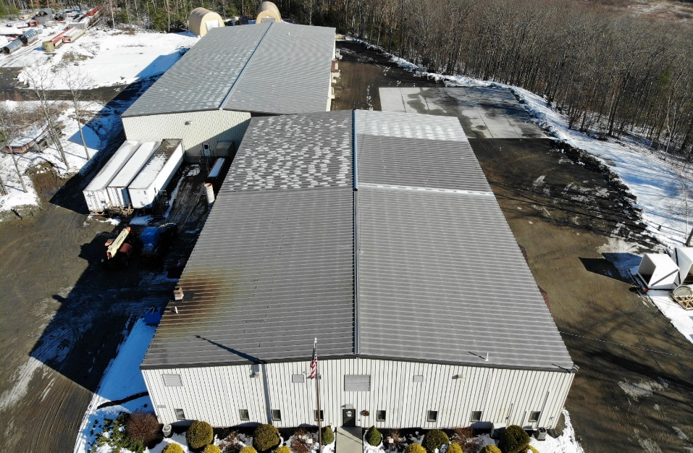
MOLDING DIVISION – OHIO & MAINE
Composite Advantage
Dayton, OH
  Facilities:
  310,000 sq. ft.
  Employees:
  95
  Manufacturing Process:
  Vacuum Infusion, Specializing in Large Structural Parts
Kenway Composites
Augusta, ME
  Facilities:
  40,000 sq. ft.
  Employees:
  50
  Manufacturing Processes:
  Open Molding, Filament Winding, Vacuum Infusion

Slide 6
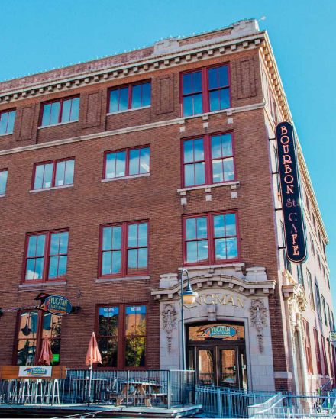
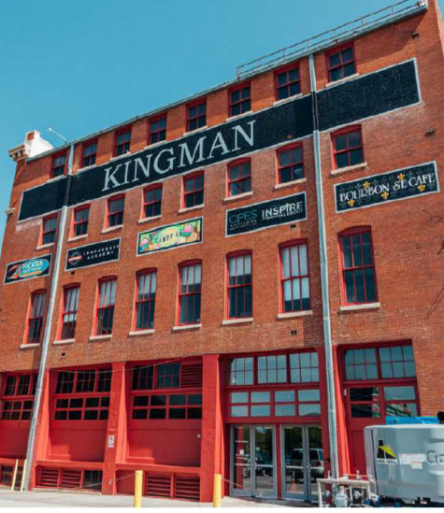
COOLING TOWERS
Tower Tech Office
Oklahoma City, OK
  Facilities:
  8,000 sq. ft.
  Employees:
  15 – Office
  Specializing in Modular
  FRP Cooling Towers

Slide 7
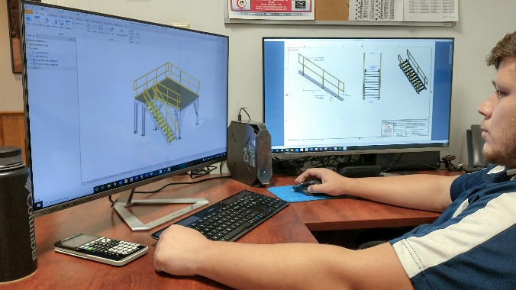
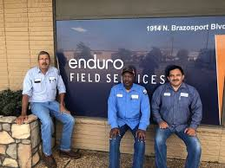
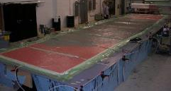
CAPABILITIES
DESIGN & ENGINEERING:
  OEM Support
  Design & Build
  Custom Parts
  Engineered Solutions
FIELD SERVICES:
  Field Service & Repair
  Maintenance
  Safety Compliance
  Specialized Coatings
  Southwest Freeport, TX
  Northeast Augusta, ME
MANUFACTURING PROCESSES:
Pultrusion
Continuous Production
Constant Cross-section
Large Quantity
Vacuum Infusion
Large Parts
Design Flexibility
Low to Medium Quantity
Filament Winding
Automated
Cylindrical Shapes
Medium Quantities
Hand Layup
Complex Shapes
Cosmetic
Prototypes, Low Quantity

Slide 8
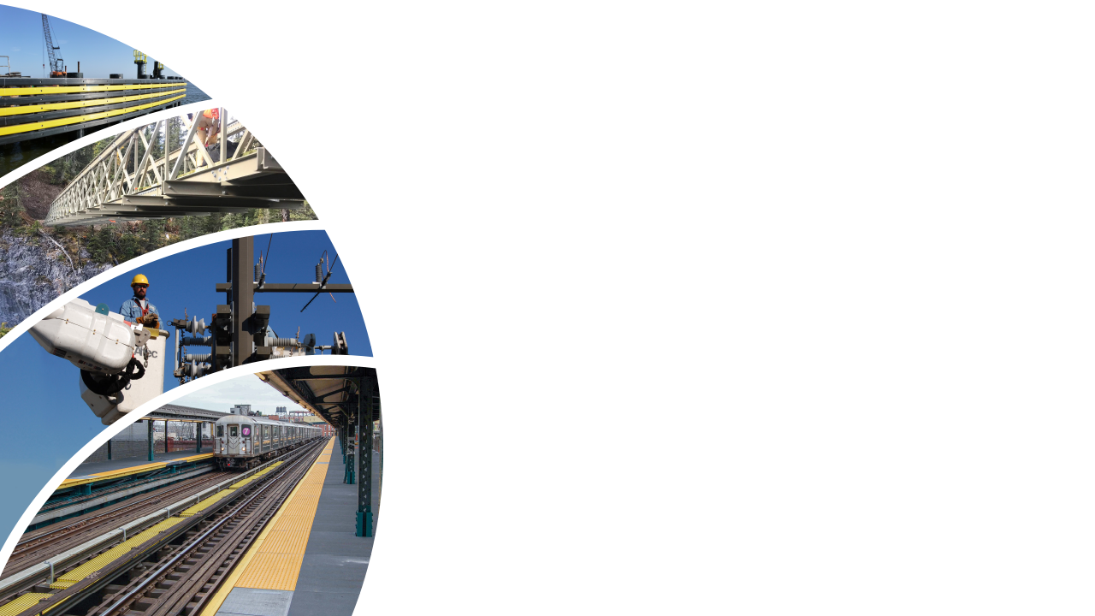
KEY INDUSTRIES & INFRASTRUCTURE PRODUCTS
Waterfront Infrastructure
Sheet & Pile Piling
Fender Protection Systems
Ship Berthing
Pier Protection Systems
Docks & Marinas
Utilities Infrastructure
Transmission & Distribution Poles
Deadend & Tangent Crossarms
Fire-resistant Poles
Microcell Poles
Bridge Infrastructure
Pedestrian Bridges
Boardwalks
Vehicle Decking
Pedestrian Decking
Sidewalks
Concrete From Deck
Rail & Transit Infrastructure
Mass Transit Platform Panels
Rail Coverboards
Water & Wastewater
Municipal Wastewater Infrastructure
FRP Tank Covers
Baffle Walls
Clarifier Products & Odor Control
Building Infrastructure
FRP Roofing
Roof Deck
Siding Products
Insulated Panels
Structural Lighting
HVAC Infrastructure
Modular FRP Cooling Towers
Cooling Tower Panels

Slide 9
KEY INDUSTRIES PRODUCTS & SERVICES
Field Services
Industrial Installation & Repair
Maintenance
Quality Assurance
Water & Wastewater
Corrosive Tanks & Facilities
FRP Structural Products
Ladders, Stairs & Railings
Pedestrian Decking Products
Non-skid Decking
Safety Railing
Mezzanine & Walkway Systems
Commercial Decking
Full Catalog of Structural Parts
  Decking, Planking & Grating
  I-Beams
  Channels
  Pipes & Tubes
  Leg Angles
  Solid Rods & Bars
  Flat Sheets
  Structural Beams
OEM & Collaborations
Both Design/Build & Build-to-Print
Custom FRP Products & Fabrication
Critical Parts of Customers’ Systems
Custom Molding
Custom Filament Winding
Custom Pultrusion
OEM Manufacturing
Cable Management
Corrosive Environments
Full Catalog of Cable Management
  Cable Trays
  Ladder Cable Trays
  Supports
  Framing
  Instrument
  Pushbutton Stands
  Wireways
  Struts

Slide 10






FIBER REINFORCED POLYMER (FRP) BENEFITS
Corrosion Resistance to Chemicals and Water
Expected life of 75+ years
Low to No Maintenance
Sustainable alternative to other materials
High Strength
Similar to steel
High safety factors
Lightweight
80% lighter than concrete
Enables large prefabricated structures
Reduced cost of support structure
Architectural/Structural Features
Molded into Structure
Variety of sizes and shapes
Many surface finish options
Color options
Design Flexibility
Engineered material
Structurally efficient to meet requirements
100% Domestic Source Material

Slide 11
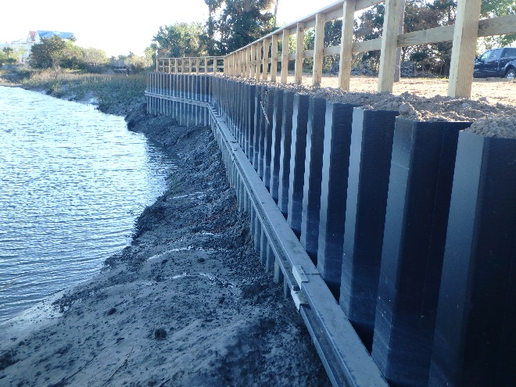
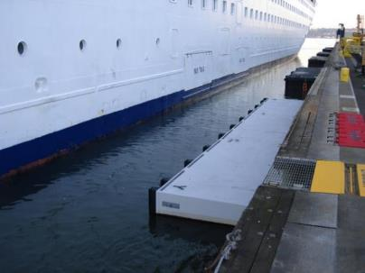
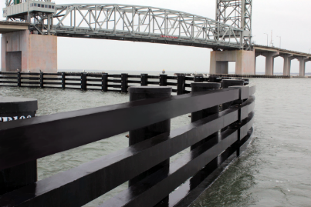
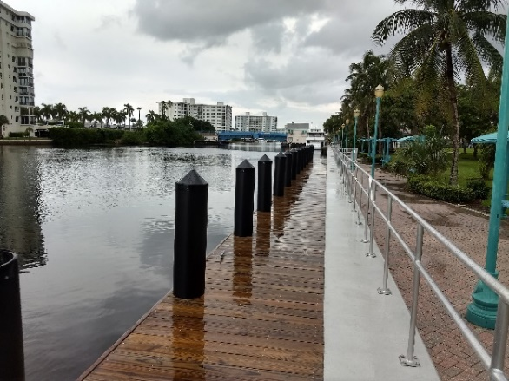
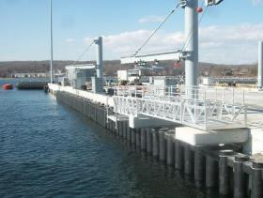
WATERFRONT INFRASTRUCTURE
Benefits
Safe for Marine Environments
Corrosion Resistant
Resilient in Storms
  StormStrong Pipe Piles
  StrormStrong Sheet Piles
Lightweight
Long Lasting
Sheet Piles
Ship Berthing
Fender Protection Systems
Docks & Marinas
Pier Protection Systems

Slide 12
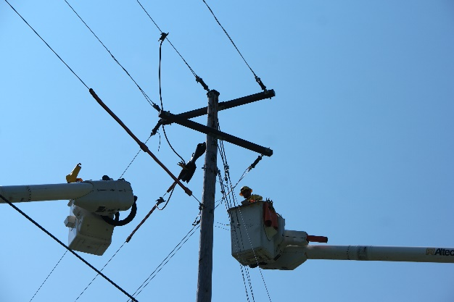
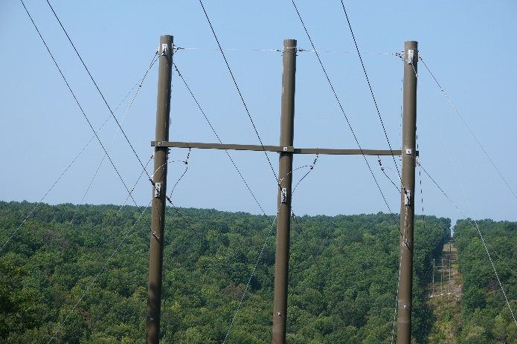
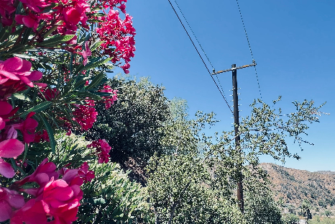
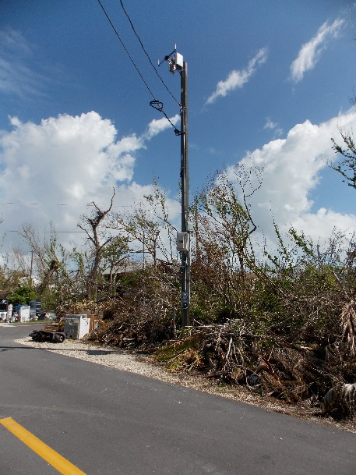
UTILITY
INFRASTRUCTURE
StormStrong Utility Poles
StormStrong Crossarms
FireStrong Utility Poles
Benefits
Ultimate Grid Reliability
Sustainable & Long Lasting
Resilient in Storms
  StormStrong® Poles & Crossarms
Fire Retardant
  FireStrong™ Poles
Lightweight
Fast Installation
Doesn’t Leach Chemicals into the Ground
Pest Resistant
Deadend and Tangent Crossarms
Transmission Poles
Distribution Poles
Microcell Poles

Slide 13
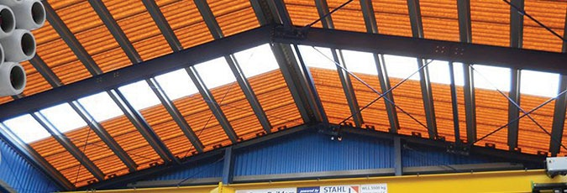
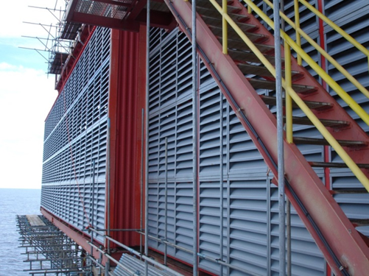
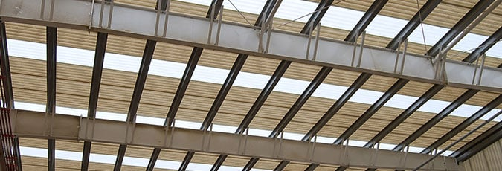
BUILDING PRODUCTS
Corrosive & Harsh Environments
Roofing & Siding Products
FRP Gutters & Downspouts
Purlin & Girts
Louvers & Ridge Vents
TuffSpan Fiberglass Building Panels & Roofing
Benefits
Energy Efficient Translucent or Semi-Translucent Products
Corrosion Resistant
FM Approved
Designed for Severe Weather & Hurricanes
RF Transparent
Low Life-Cycle Cost
Louvers & Ridge Vents
FRP Daylighting Panels

Slide 14
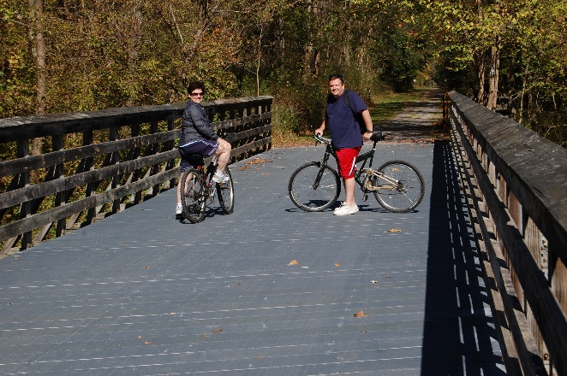
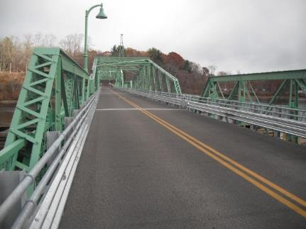
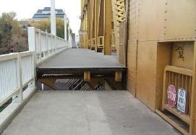
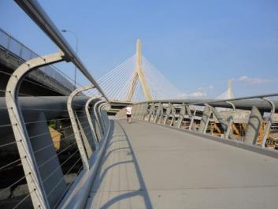
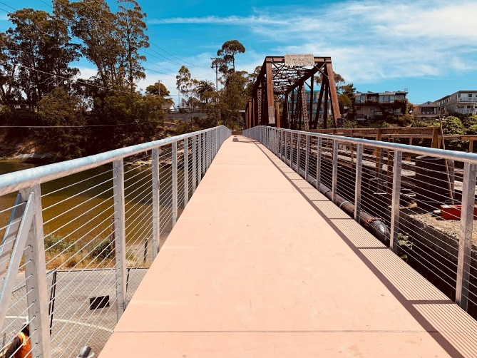
BRIDGE DECKING
Vehicle Decking
Pedestrian Decking
Sidewalks
Benefits
Long lasting
Lightweight
Fast installation

Slide 15
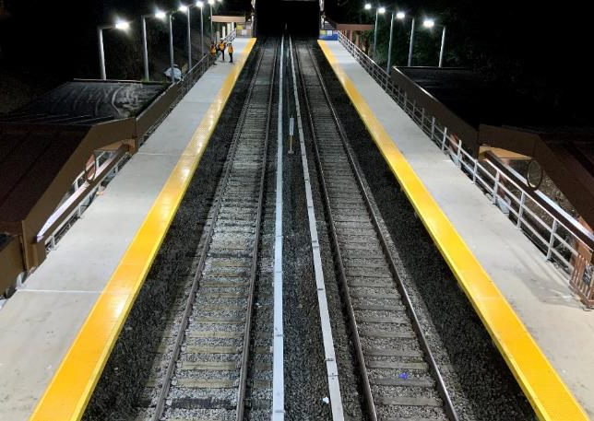
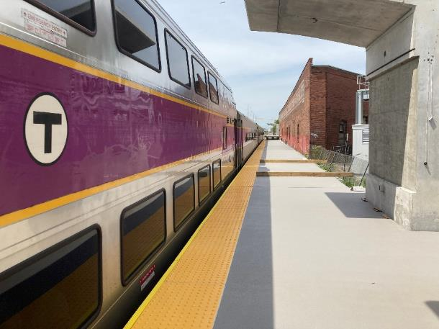
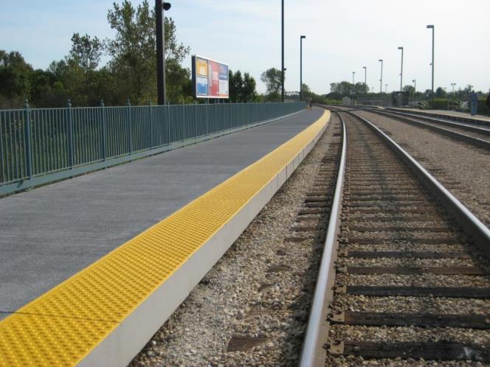
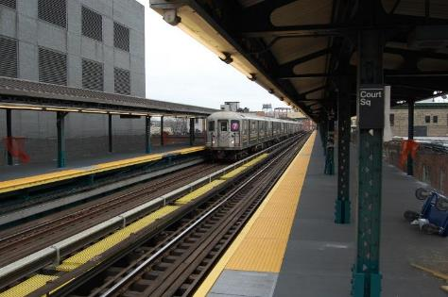
RAIL PLATFORMS & TRANSIT INFRASTRUCTURE
Platform Panels
Rail Covers
Benefits
Long lasting
Corrosion resistance
Fast installation

Slide 16
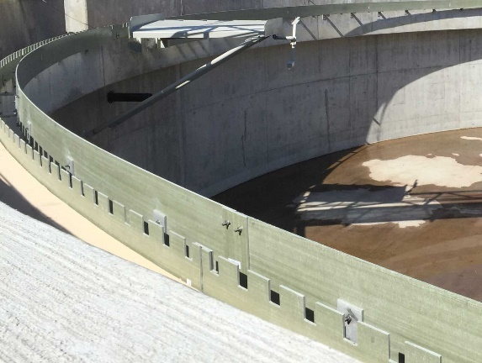
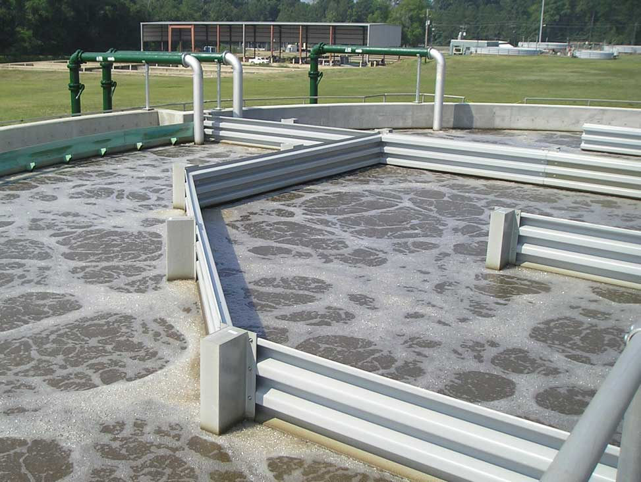
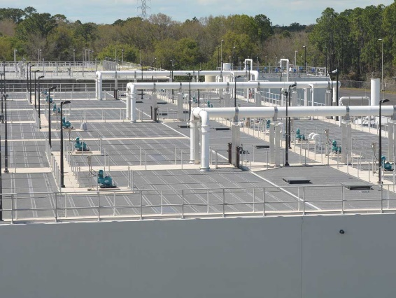
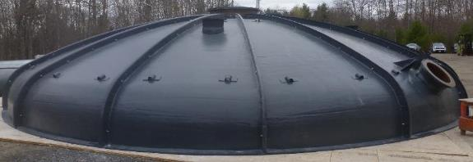
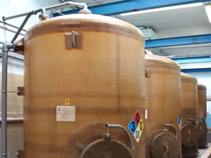
WATER & WASTEWATER INFRASTRUCTURE
Sustainable FRP Design
Fiberglass Tank Covers
Baffle Walls
Clarifier Products
Benefits:
  Odor control
  Improved tank process efficiencies
  Protection from debris and UV
  Easy to install
  Lightweight - less risk to existing, older structures
  Improved tank cover operator accessibility and safety
FRP Clarifier Products
Fiberglass Baffle Wall
Fiberglass Tank Covers
Cover Systems
Municipal Odor Control

Slide 17
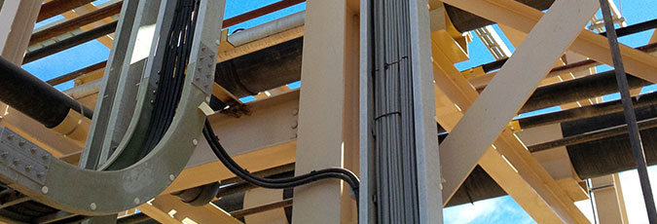
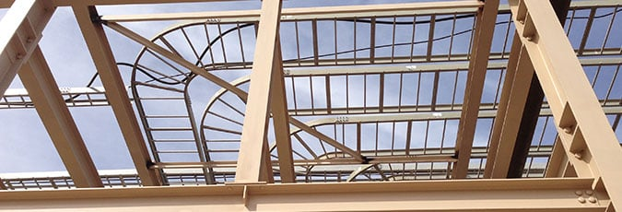
CABLE MANAGEMENT SYSTEMS
Corrosive & Harsh Environments
Cable Management Products
Standard & Ladder Cable Trays
Wireways, Stands & Struts
Structural supports for high to low voltage electrical, instrumentation, sensor and communication cables
Resin technologies include non-conductive and conductive technologies in addition to safer FST systems
Industrial Cable & Wire Management
Fiberglass Ladder Type Cable Tray

Slide 18
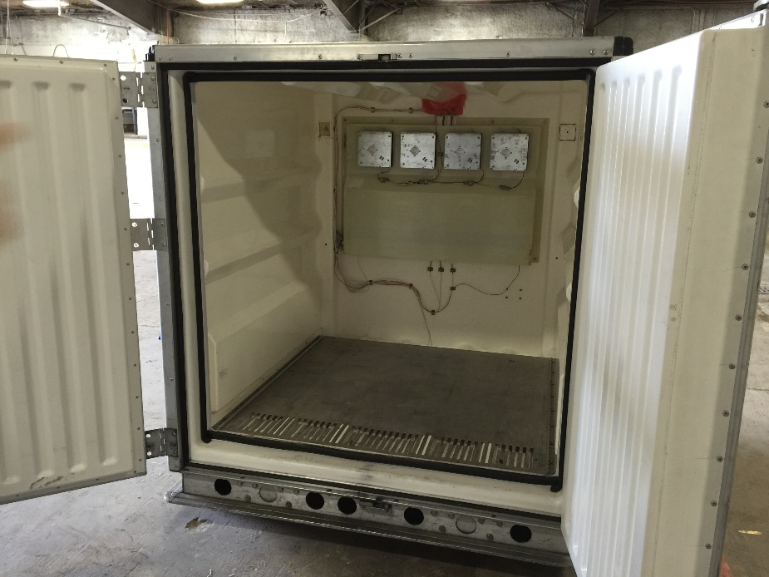
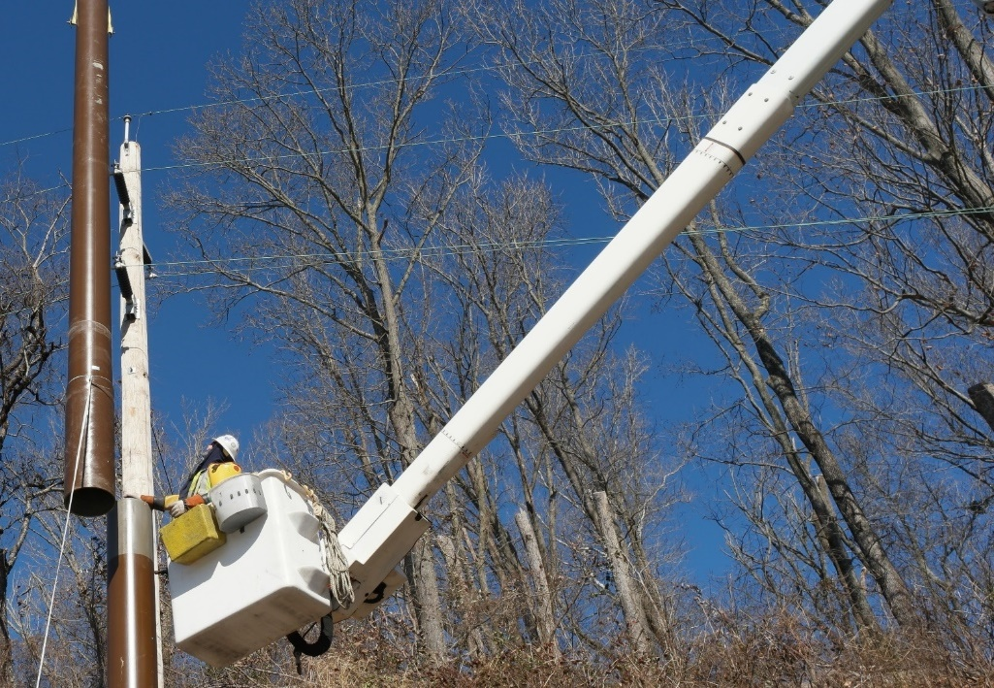
OEM & CUSTOM MANUFACTURING
Most are Long-term Productions
Critical parts of our customer’s systems
Both Design/Build & Build-to-Print
Most are proprietary for economic competitiveness
Cold Storage Medical Shipping Containers
Bucket Truck Jibs
Crane Outrigger Pads

Slide 19
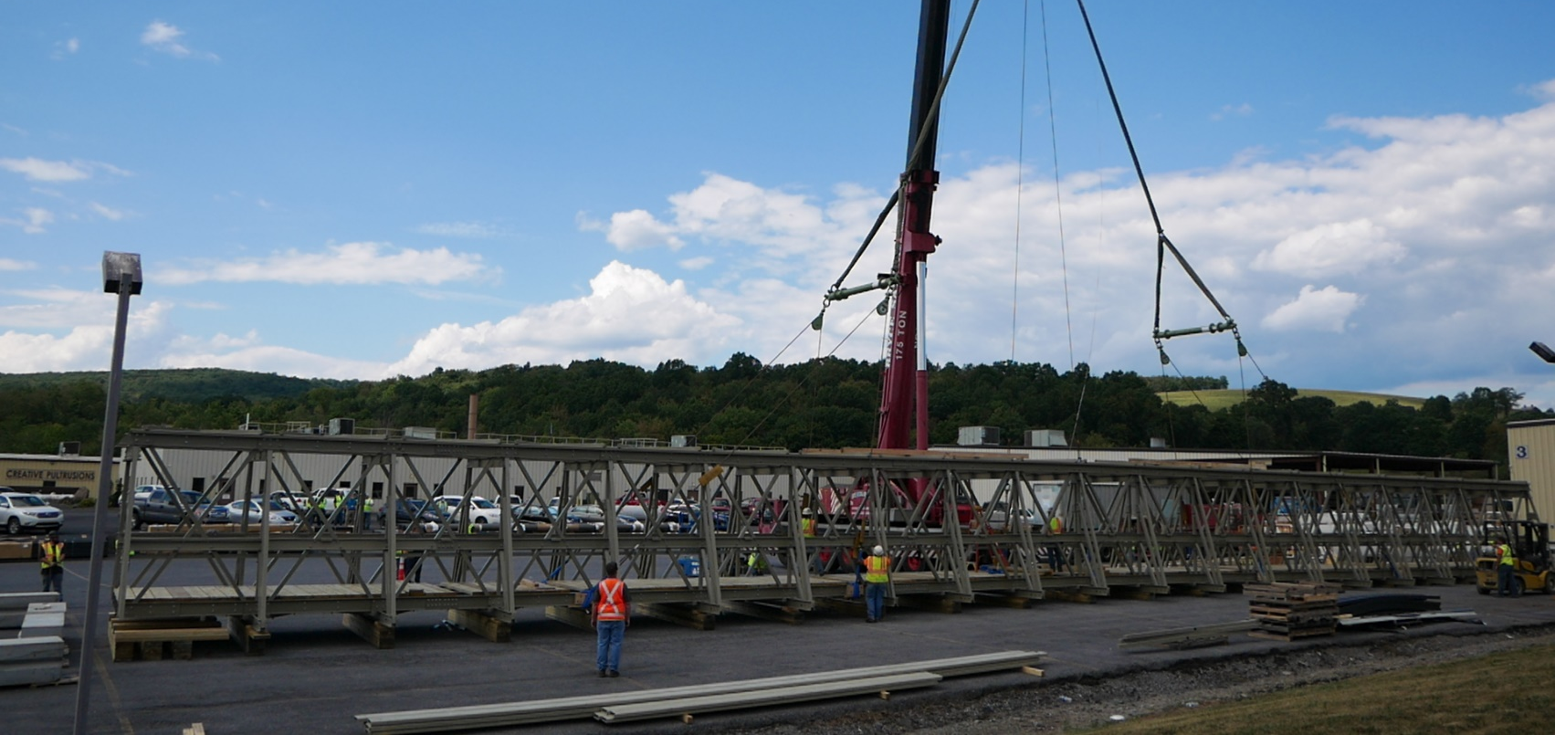
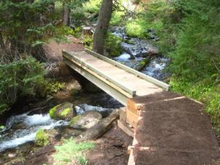
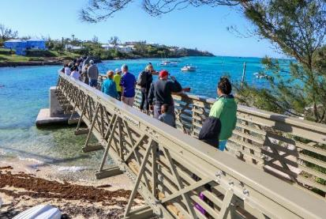
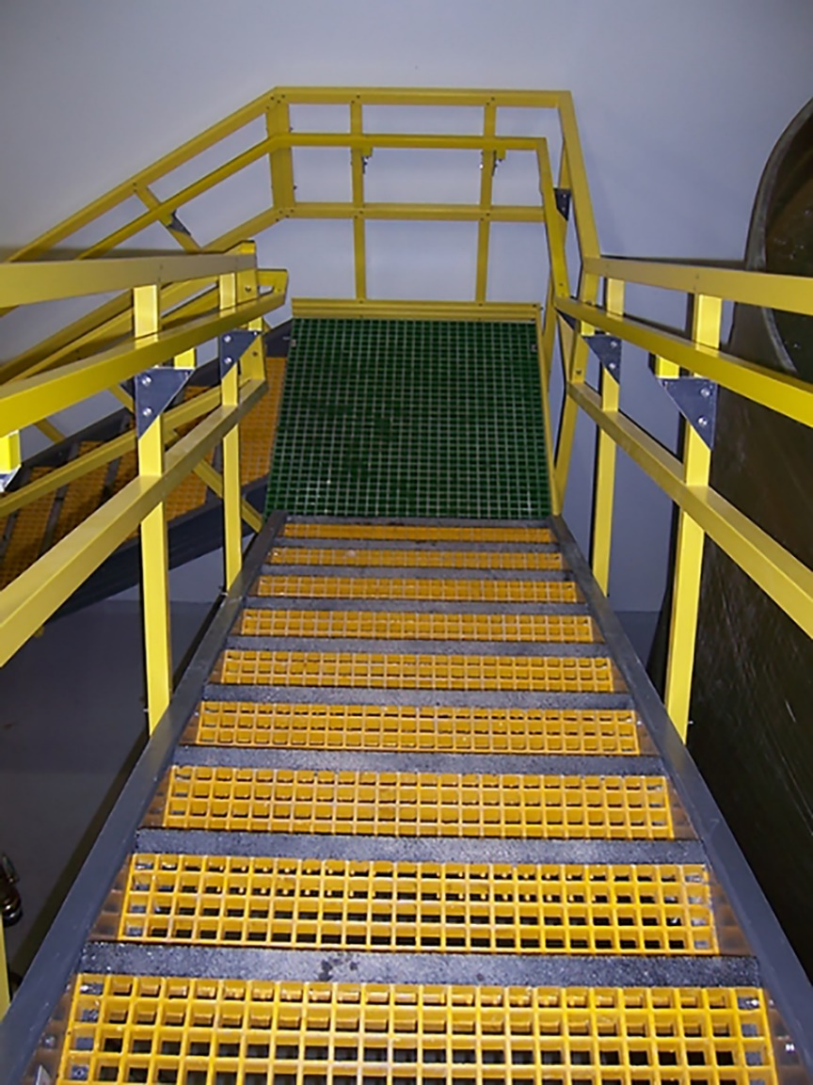
PEDESTRIAN & SAFETY ACCESS STRUCTURES
Pedestrian Bridges
Industrial & Safety Access Structures
  Ladders
  Stairs
  Handrails
Sidewalks
Boardwalks

Slide 20
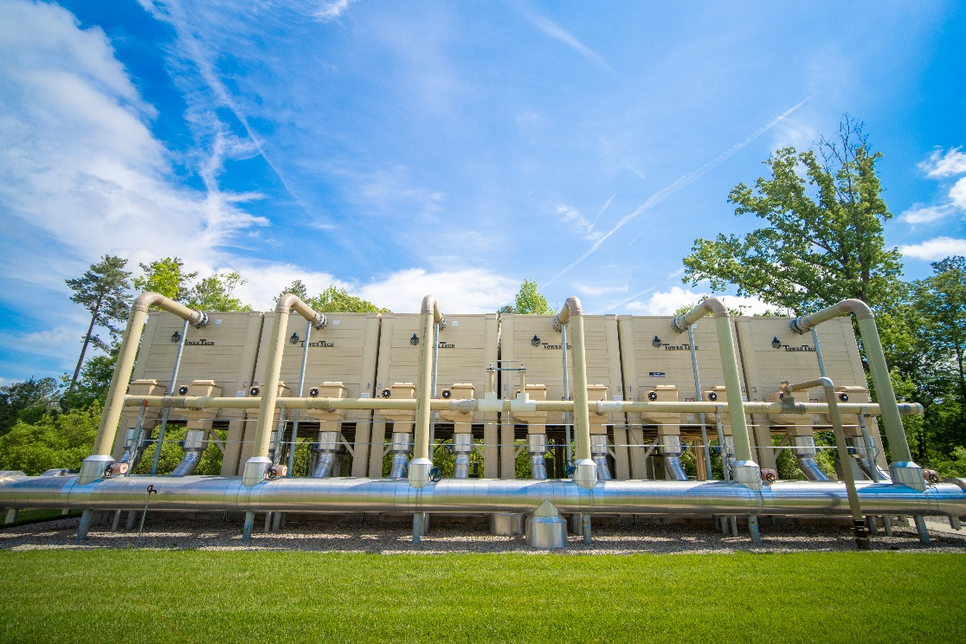
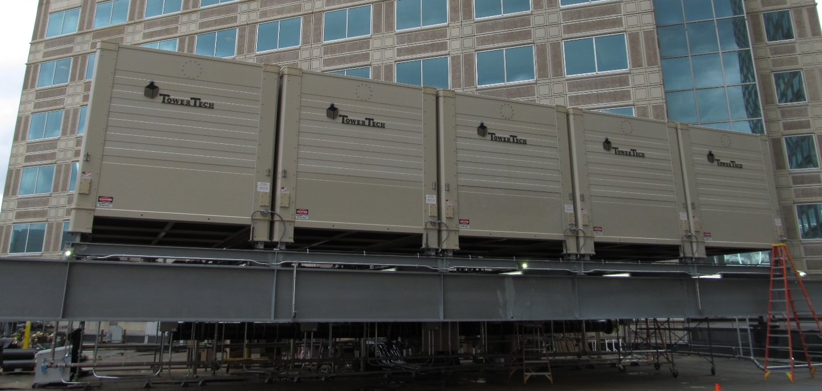
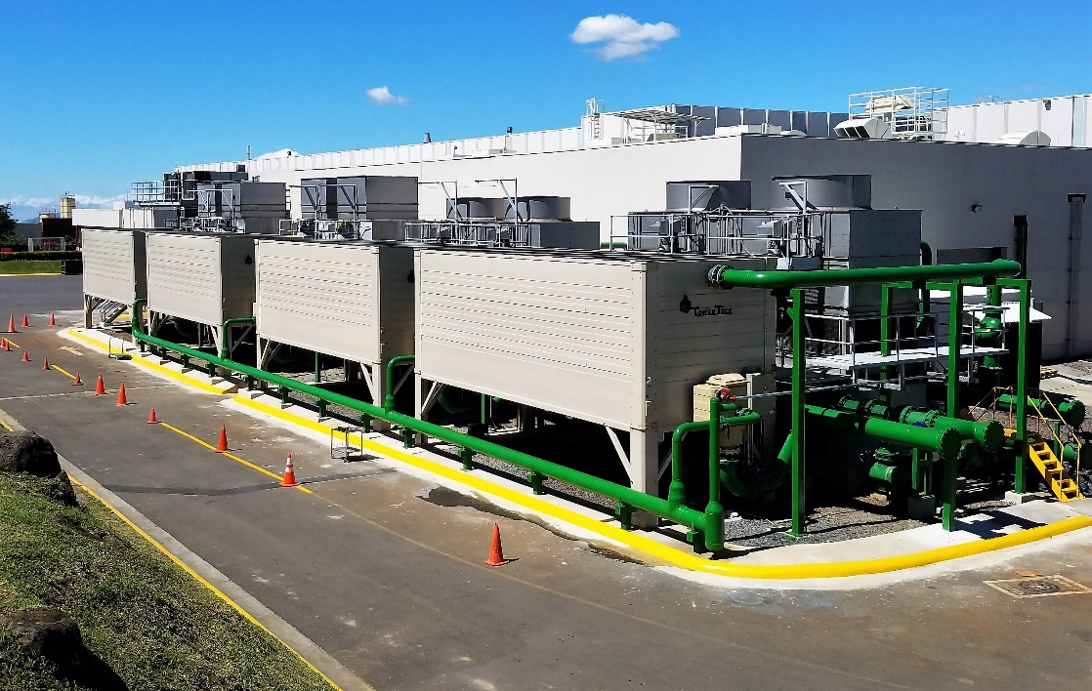
MODULAR COOLING TOWERS
Sustainable FRP Design
Lower operating costs
Fast installation
High reliability

Slide 21
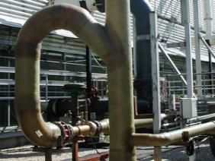
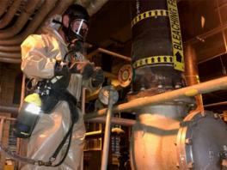
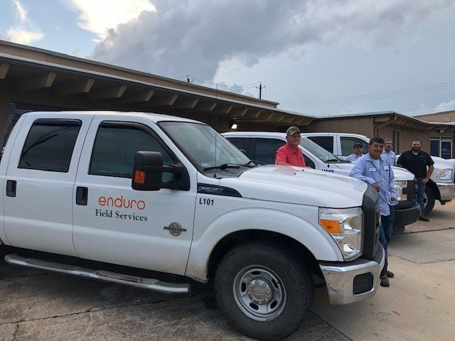


FIELD SERVICES & REPAIR
FRP Repair & Maintenance
Water & Wastewater Product Installations
Industrial Installations
Industrial & Specialized Coatings
Safety, Compliance & Quality Assurance
Facilities
  Northeast Freeport, TX USA
  Southwest Augusta, ME USA
Industrial Corrosion Pipes, Ducts & Tanks
Industrial Field Service & Repair
Field Services Crews (Northeast & Southwest)
Field Repairs

Slide 22
APPENDIX

